Slide 1


Informatics Standards & Interoperability
A Foundation for Healthcare Information Management
Abdul-Malik Shakir
Principal Consultant, Shakir Consulting
Presented to:
The University of Texas M. D. Anderson Cancer Center
Houston, Texas
March 30, 2009
Session 1 of 4

Slide 2
About Me
Abdul-Malik Shakir
Information Management Strategist
City of Hope National Medical Center, Duarte, CA
Since December 2008
Member of Health Level Seven since 1991
Co-Chair of the HL7 Education Workgroup
Active member of:
Architectural Review Board (ArB)
Public Health and Emergency Response Workgroup (PHER)
Regulated Clinical Research Information Management Workgroup (RCRIM)
Modeling and Methodology Workgroup (MnM)
RIM-Based Application Architecture Workgroup (RIMBAA)
Principal Consultant for Shakir Consulting since 2001
Senior Technical Architecture Advisor for Cal2Cal Corporation assisting the Los Angeles County Public Health Department since 2005
UML Modeling Facilitator for Clinical Data Interchange Standards Consortium (CDISC) since 2008
BRIDG Model Harmonization Facilitator for International Institute for Safety in Medicine (II4SM) since 2008

Slide 3
Two Day Tutorial Agenda
Session 1 Healthcare Informatics Standards & Interoperability | Session 3 Design Level Static Information Models
Session 2 Domain Analysis Modeling | Session 4 RIM-Based Relational Database Design
Monday
Tuesday

Slide 4
Presentation Overview
Healthcare Informatics Standards Collaboration
Role of ANSI, ONC, and HITSP
EHR Clinical Research Value Case
Leading Healthcare Data Interchange SDOs
Health Level Seven (HL7)
HL7 the Organization
HL7 the Standards
Implementation Guides and Profiles
Controlled Clinical Terminology
LOINC / SNOMED
HL7 Controlled Terminology Service project
Interoperability Framework Concepts
Semantic Interoperability Building Blocks
Healthcare Systems and Services Interoperability
Healthcare Information Integration Infrastructure

Slide 5
Healthcare Informatics Standards Collaboration
Healthcare organizations have found it advantageous to collaborate in the pursuit of solutions to healthcare information management issues.
Healthcare provider, payor, vendor, consulting, and regulatory organizations have formed industry groups to study information management issues and develop standard solutions to their common problems.
These standards include standards for data interchange, clinical vocabularies, services, security, document architectures, and many others.

Slide 6

Electronic Information Interchange
Claims/Prescriptions
Referral Process
Eligibility
Eligibility
Claim Status
Referral Process
Claim/Status
Pharmacies
Payors
Physicians
Public Health
Medical Records
Medical Society
Patient Data
Family Planning
Lab results
Mental Health
County/Community
Entities
Hospitals
Enrollment
Orders
Insurance Updates
Results
Health Information
Images
Testing Organizations
Lab/Images
Employers
Government
Medicare/Medicaid
Patients/Consumers
Notes:
The utilization of Ancillary services will become much more useful after the needs of the Physician and Patient are met.

Slide 7
Leading Healthcare Data Interchange Standards
Clinical
System
Materials
Management
Billing,
claims
reimbursement
HL7
X12N
Retail Pharmacy Orders & Reimbursement
X12N / HL7 (Non-US only)
Healthcare
Information
System
NCPDP
HL7
Immunization
Database
Waveforms
HL7
HL7, X12N
Images,
pictures
Agency Reporting
DICOM
HL7
HL7, X12N
IEEE MIB, ASTM
Adverse
Events Reporting
Provider
Repository
Bedside
Instruments

Slide 8
American National Standards Institute
The American National Standards Institute (ANSI) is a private non-profit organization that oversees the development of voluntary consensus standards for products, services, processes, systems, and personnel in the United States.
The organization also coordinates U.S. standards with international standards so that American products can be used worldwide.
ANSI accredits standards that are developed by representatives of standards developing organizations, government agencies, consumer groups, companies, and others.
These standards ensure that the characteristics and performance of products are consistent, that people use the same definitions and terms, and that products are tested the same way.

Slide 9
American National Standards
ANSI does not develop standards, the Institute facilitates the development of American National Standards (ANS) by accrediting the procedures of standards developing organizations (SDOs).
ANSI accreditation signifies that the procedures used by standards setting organizations meet the Institute's requirements for openness, balance, consensus, and due process.
The Institute is the official U.S. representative to the two major international standards organizations, the International Organization for Standardization (ISO) and the International Electro technical Commission (IEC).
In many instances, U.S. standards are taken forward to ISO and IEC, through ANSI, where they are adopted in whole or in part as international standards.

Slide 10
National Coordinator for Health Information Technology
The Office of the National Coordinator for Health Information Technology (ONC) provides counsel to the Secretary of HHS for the development and nationwide implementation of an interoperable health information technology infrastructure.
The National Coordinator for Health Information Technology:
Serves as the Secretary's principal advisor on the development, application, and use of health information technology;
Coordinates the Department of Health and Human Services' (HHS) health information technology policies and programs internally and with other relevant executive branch agencies;
Develops, maintains, and directs the implementation of HHS’ strategic plan to guide the nationwide implementation of interoperable health information technology in both the public and private health care sectors, to the extent permitted by law; and
Provides comments and advice at the request of Office of Management and Budget (OMB) regarding specific Federal health information technology programs.

Slide 11
Healthcare Information Technology Standards Panel
In the fall of 2005, the National Coordinator for Health Information Technology (ONC) awarded multiple contracts to advance widespread adoption of interoperable electronic health records (EHRs).
The contracts targeted the creation of processes to harmonize standards, certify EHR applications, develop nationwide health information network prototypes and recommend necessary changes to standardized diverse security and privacy policies.
The American National Standards Institute (ANSI), in cooperation with strategic partners HIMSS, Booz Allen Hamilton, and Advanced Technology Institute, was selected to administer the standards harmonization initiative.
The resulting collaborative, known as the Healthcare Information Technology Standards Panel (HITSP), brings together experts from across the healthcare community.

Slide 12
HITSP Interoperability Specification
An HITSP Interoperability Specification (IS) is a suite of documents that, taken as a whole, provide a detailed map to existing standards and specifications that satisfy the requirements imposed by a given Use/Value Case.
Each Interoperability Specification focuses on a set of constrained standards for information interchange that address the core requirements of one or more Use Cases.
The HITSP Interoperability Specification defines how two or more systems exchange standard data content in a standardized manner.
Interoperability Specifications define the necessary business and technical actors, the transactions between them including the message, content and terminology standards for the actual information exchange.
Interoperability Specifications do not specify the functional requirements or behaviors of the systems or applications.

Slide 13
Informatics Standards Coordination Bodies

Slide 14
EHR Clinical Research Value Case Workgroup
In 2008, the American National Standards Institute formed the EHR Clinical Research Value Case Workgroup to promote convergence within the global clinical research and healthcare arenas.
The Workgroup identifies priorities for the harmonization of the technical standards that are necessary to ensure the interoperability of electronic health records (EHRs) and clinical research applications.
Priorities identified by the workgroup will be transmitted to the Healthcare Information Technology Standards Panel (HITSP) for harmonization and the development of HITSP Interoperability Specifications (IS).
The first set of priorities specified by the workgroup are published in the “Value Case for the Use Of Electronic Health Records in Clinical Research”.

Slide 15
Clinical Research Value Case
This Value Case conveys three requirements for the ability of an EHR to support clinical research activities:
the processes necessary to move data from one system to another to enable EHR data to be used in the clinical research endeavor.
the data elements commonly present in an EHR that are critical to a broad range of clinical research activities.
the value proposition for the use of harmonized standards and interoperability specification for the use of EHR data to support clinical research studies.

Slide 16
Clinical Research Value Case

Slide 17
Clinical Research Value Case Public Comment Period
The public comment period for the Electronic Health Record Clinical Research Value Case opened on March 6, 2009.
The value case addresses the ability to exchange a set of core research data elements from an electronic health record to clinical research systems.
The documents posted include a high-level value case, a value case extension document and a detailed use case.
These documents can be found at http://publicaa.ansi.org/sites/apdl/EHR Clinical Research/Forms/AllItems.aspx
Comments are to be submitted to the EHR Clinical Research workgroup via EHR-CR@ansi.org, using the format suggestion in the feedback form, by 5PM/ET on FRIDAY, APRIL 3rd.

Slide 18
Pathway to Interoperability
Input

Slide 19
Leading Healthcare Data Interchange SDOs
IEEE
Institute of Electrical and Electronic Engineers
NCPDP
National Council for Prescription Drug Programs
X12N
Insurance Subcommittee of X12
ASTM
American Society for Testing and Materials
DICOM
Digital Imaging and Communications in Medicine
HL7
Health Level Seven

Slide 20
Leading Healthcare Data Interchange SDOs
IEEE
Instrumentation communication standards and generalized information interchange standards
NCPDP
Standards for communication of prescription, billing, and other pharmacy material
X12N
Standards for exchange of healthcare insurance and billing information
ASTM
Lab reporting standards and standard guide for content and structure of computer-based patient records
DICOM
Standards for exchanging digital radiology images
HL7
Inter-application interoperability standards for healthcare

Slide 21
HL7 and X12N
HL7 and X12N are standards development organizations accredited by the American National Standards Institute (ANSI).
Each organization adheres to a strict and well-defined set of operating procedures that ensures consensus, openness and balance of interest.
HL7 develops standards that enable disparate healthcare applications to exchange key sets of clinical and administrative data.
X12N develops specification that enable the electronic interchange of healthcare insurance and claims processing data.
HL7
Insurance / Billing
Clinical / Administrative
X12N

Slide 22
An X12N Data Interchange Scenario
Patient Billing
Application
System
Dataset
Program
Module
User Interface
Patient Billing
Application
System
Outbound
Transformation
Inbound
Transformation
Claim
Transaction
A to B
Transformation
Remittance
Transaction
B to A
Transformation
Inbound
Transformation
Outbound
Transformation
Claims Processing
Application
System
Claims Processing
Application
System
User Interface
Program
Module
Dataset

Slide 23
An HL7 Data Interchange Scenario
Order Entry
Application
System
Dataset
Program
Module
User Interface
Order Entry
Application
System
Outbound
Transformation
Inbound
Transformation
Lab Order
Transaction
Lab Result
Transaction
A to B
Transformation
B to A
Transformation
Inbound
Transformation
Outbound
Transformation
Laboratory
Application
System
Laboratory
Application
System
User Interface
Program
Module
Dataset

Slide 24

ASC X12 brings together business and industry professionals in a cross-industry forum to develop and support electronic data exchange standards and related documents for the national and international marketplace to enhance business processes, reduce costs and expand organizational reach

Slide 25
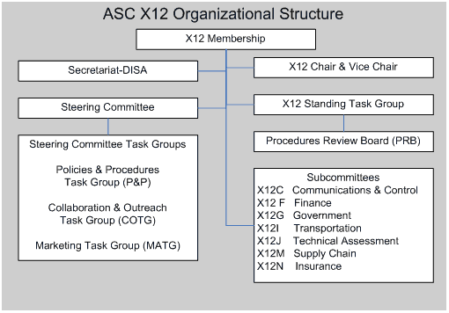
ASC X12 Organization

Slide 26
X12 HIPAA Transactions
Health Claims or Equivalent Encounter Information Standard Transaction Form: X12-837 - Health Care Claim
Claims Payment and Remittance Advice Standard Transaction Form: X12-835 - Health Care Claim Payment/Advice Standard
Healthcare Claims Status Standard Transaction Form: X12-276/277 - Health Care Claim Status Request and Response
Coordination of Benefits Standard Transaction Form: X12-837 - Health Care Claim
Referral Certification and Authorization Standard Transaction Form: X12-278 - Health Care Services Review - Request for Review and Response
Enrollment and Disenrollment in a Health Plan Standard Transaction Form: X12-834
Premium Payments Standard Transaction Form: X12-820
Eligibility for a Health Plan Standard Transaction Form: X12-270/271
First Report of Injury Standard Transaction Form: X12-148
Claims Attachments Standard Transaction Form: X12-275

Slide 27

Health Level Seven: Who
Health Level Seven (HL7) is an American National Standards Institute (ANSI) Accredited Standards Developer.
The mission of HL7 is to provide standards for interoperability that improve care delivery, optimize workflow, reduce ambiguity and enhance knowledge transfer among its stakeholders, including healthcare providers, government agencies, the vendor community, fellow SDOs and patients.

Slide 28























HL7 Affiliates: Who
Colombia
Austria
Croatia
Chile
Argentina
South Korea
Australia
Spain
New Zealand
Sweden
Switzerland
Netherlands
Brazil
Taiwan
Romania
Mexico
Canada
Turkey
Singapore
Japan
United Kingdom
China
Uruguay
United States
Italy
Czech Republic
Ireland
Denmark
Greece
India
Finland
France
Germany
Notes:
28

Slide 29
HL7 Benefactors: Who
Accenture Health & Life Sciences
Booz Allen Hamilton
Centers for Disease Control
Duke Translational Medicine Institute
Eclipsys Corporation
Eli Lilly and Company
Epic Systems
European Medicines Agency
Food and Drug Administration
GE Healthcare Integrated IT Solutions
GlaxoSmithKline
IBM Corporation
Intel Corporation, Digital Health Group
InterSystems
Kaiser Permanente
Lockheed Martin
McKesson Provider Technologies
Microsoft Corporation
NHS National Programme for IT
NICTIZ National Healthcare
Novartis
Oracle Corporation - Healthcare
Partners HealthCare System, Inc..
Pfizer Inc.
Philips Healthcare
Quadramed Corporation
Quest Diagnostics, Incorporated
Siemens Healthcare
St. Jude Medical
Sunquest Information Systems
Thomson Reuters
U.S. DOD, Military Health System
U.S. Department of Veterans Affairs
Wyeth Pharmaceuticals

Slide 30
HL7 Workgroups
Affiliates Council
Anatomic Pathology
Architectural Review Board
Arden Syntax
Attachments
Child Health
Clinical Context Object Workgroup
Clinical Decision Support
Clinical Genomics
Clinical Interoperability Council
Clinical Statement
Common Message Element Types
Community Based Collaborative Care
Domain Experts Steering Division
Dynamic Model
Education
Electronic Health Records
Electronic Services
Emergency Care
Financial Management
Foundation and Technology Steering Division
Generation of Anesthesia Standards
Governance and Operations Government Projects
Health Care Devices
Imaging Integration
Implementable Technology Specifications
Implementation / Conformance
Infrastructure and Messaging
International Mentoring Committee
Marketing Modeling and Methodology
Orders and Observations
Outreach Committee for Clinical Research
Patient Administration
Patient Care
Patient Safety
Pharmacy
Process Improvement
Project Services
Public Health and Emergency Response
Publishing
Regulated Clinical Research Information Management
RIMBAA
Scheduling and Logistics
Security
Services Oriented Architecture
Structure and Semantic Design Steering Division
Structured Documents
Technical and Support Services Steering Division
Technical Steering Committee
Templates
Terminfo Project
Tooling
Vocabulary
As of January 2009

Slide 31
Research Specific Workgroups
Outreach Committee for Clinical Research (OCCR)
To promote interchange between HL7 and external organizations and agencies involved in the various aspects of clinical and pre-clinical research. Broaden opportunities for participation of the clinical research communities in HL7 activities. Provide an introduction and guide to the principals and processes of HL7 to the regulated and non-regulated clinical/pre-clinical research communities. Develop opportunities among clinical/pre-clinical research stakeholders for HL7-related education, as well as to provide a forum for these stakeholders to share educational resources; and enhance the domain expertise of the HL7 Work Groups relative to the concerns of the clinical research communities.
Regulated Clinical Research Information Management (RCRIM)
This Work Group supports the HL7 mission to create and promote HL7 standards by developing standards to improve or enhance information management during clinical research and regulatory evaluation of the safety, efficacy and quality of therapeutic products and procedures worldwide. The Work Group defines messages, document structures, and terminology to support the systems and processes used in the collection, storage, distribution, integration and analysis of such information. Areas of interest are Products and Studies generated as a result of protocol driven research in a regulated environment.

Slide 32
HL7 Strategies
Develop coherent, extendible standards that permit structured, encoded health care information of the type required to support patient care, to be exchanged between computer applications while preserving meaning.
Develop a formal methodology to support the creation of HL7 standards from the HL7 Reference Information Model (RIM).
Educate the healthcare industry, policy makers, and the general public concerning the benefits of healthcare information standardization generally and HL7 standards specifically.
Promote the use of HL7 standards world-wide through the creation of HL7 International Affiliate organizations, which participate in developing HL7 standards and which localize HL7 standards as required.
Stimulate, encourage and facilitate domain expert participation in HL7 to develop healthcare information standards in their area of expertise.
Collaborate with other standards development organizations and national and international sanctioning bodies (e.g. ANSI and ISO), in both the healthcare and information infrastructure domains to promote the use of supportive and compatible standards.
Collaborate with healthcare information technology users to ensure that HL7 standards meet real-world requirements, and that appropriate standards development efforts are initiated by HL7 to meet emergent requirements.

Slide 33
The Family of HL7 Standards: What
Standardization of knowledge representation (Arden / GELLO)
Specification of components for context management (CMA)
Standardization of clinical document structures (CDA)
Electronic Health Record System Functional Model (EHR-S)
Application protocol for electronic data exchange in healthcare environments (messages)
Support for use of healthcare services in a Service Oriented Architecture (SOA)
Specification of robust vocabulary definitions for use in clinical messages and documents
Work in the area of security, privacy, confidentiality, and accountability

Slide 34
Knowledge Representation (Arden)
This specification is an outcome of the Columbia-Presbyterian Medical Center 1989 Arden Homestead retreat on sharing health knowledge bases.
The first version of this standard was developed under the auspices of the American Society for Testing and Materials (ASTM) and published in April 1992 as ASTM E1460-92.
This specification covers the sharing of computerized health knowledge bases among personnel, information systems, and institutions.
The scope has been limited to those knowledge bases that can be represented as a set of discrete modules.
Each module, referred to as a Medical Logic Module (MLM), contains sufficient knowledge to make a single decision.
Contraindication alerts, management suggestions, data interpretations, and treatment protocols are examples of the health knowledge that can be represented using MLMs.
Health personnel can create MLMs directly using this format, and the resulting MLMs can be used directly by an information system that conforms to this specification.

Slide 35
Knowledge Representation (GELLO)
GELLO a purpose-specific, class-based, object-oriented (OO) language that is based on the OMG Object Constraint Language (OCL) standard.
The GELLO language includes both query and expression sublanguages and can be used to:
Build up queries to extract and manipulate data from medical records.
Construct decision criteria by building up expressions to reason about particular data features/values.
Create expressions, formulae, and queries for applications within other HL7 standards.
The query and expression languages share a common OO vMR data model that provides a standard interface to heterogeneous medical record systems.
The object-oriented approach for the language has the flexibility and extensibility that is needed for implementation in a broad range of applications.
To enabling guidelines to successfully support different data models GELLO only provides basic built-in data types, while providing the necessary mechanisms to access an underlying data model with all its associated classes and methods.

Slide 36
Context Management Architecture (CMA)
The Health Level Seven Context Management Architecture (CMA) enables multiple applications to be automatically coordinated and synchronized in clinically meaningful ways at the point-of-use.
The CMA establishes the basis for bringing interoperability among healthcare applications to the point-of-use, such as the clinical desktop.
Clinical context is state information that a user establishes and modifies while interacting with healthcare applications at the point-of-use (e.g., a clinical desktop).
The context is common because it establishes parameters that should uniformly affect the behavior or operation of multiple healthcare applications.
The context needs to be managed so that the user has a way of controlling it, and so that applications have a way of robustly coordinating their behavior as the context changes.

Slide 37
Clinical Document Architecture (CDA)
The HL7 Clinical Document Architecture (CDA) is a document markup standard that specifies the structure and semantics of "clinical documents" for the purpose of exchange.
A clinical document contains observations and services and has the following characteristics:
Persistence – A clinical document continues to exist in an unaltered state, for a time period defined by local and regulatory requirements.
Stewardship – A clinical document is maintained by an organization entrusted with its care.
Potential for authentication - A clinical document is an assemblage of information that is intended to be legally authenticated.
Context - A clinical document establishes the default context for its contents.
Wholeness - Authentication of a clinical document applies to the whole and does not apply to portions of the document without the full context of the document.
Human readability – A clinical document is human readable.

Slide 38
Electronic Health Record System (EHR-S)
The HL7 EHR System Functional Model and Standard DSTU provides a reference list of functions that may be present in an Electronic Health Record System (EHR-S), from a user perspective, to enable consistent expression of system functionality.
This EHR-S Model, through the creation of Profiles, enables a standardized description and common understanding of functions sought or available in a given setting.
When adopted, the EHR-S Model will promote a common understanding of individual EHR-S functions. This will serve the following purposes:
Be a communication link between EHR-S functions and end user defined benefits such as patient safety, quality outcomes and cost efficiencies.
Promote a common understanding, and eventually, conformance measures of EHR functions upon which developers, vendors, users and other interested parties can plan and evaluate EHR-S functions.
Provide the necessary framework to drive the requirements and applications of next level standards, such as EHR content, coding, information models, constructs and interoperability.
Establish a standards-based method by which each realm (country) can apply these EHR functions to its individually defined care settings and priorities.

Slide 39
HL7 Messaging Standards
Version 2.x & Version 3.0

Slide 40
HL7 v1.0, v2.0, and v2.x: What
HL7 1.0 originated in 1987 as a result of the frustrations of hospital CIOs seeking an open standard for vendors to use to interface the clinical systems used within their organizations.
The first set of messages were Orders and ADT. HL7 v1.0 was created in six months. It was not widely implemented but did a good job of establishing the foundation for approaching interfaces in a standard way.
HL7 v2.0 introduced the concept of triggers, added additional detail to the Message header, and expanded the set of messages to include billing. Like HL7 v1.0, HL7 v2.0 was not widely implemented.
HL7 v2.0 was used in the first HL7 HIMSS demonstration held at the Anaheim Convention Center in February 1989
HL7 v2.1 published in March 1990 was the first version of HL7 to be widely implemented. Today more than 90% of the hospitals in the United States use one or more versions of the HL7 v2.x standards.

Slide 41
An HL7 Messaging Scenario: Why
Dataset
Program
Module
User Interface
Order Entry
Application
System
Order Entry
Application
System
Message Creation
Message Parsing
Lab Order
Transaction
Lab Result
Transaction
A to B
Transformation
B to A
Transformation
Laboratory
Application
System
Message Parsing
Message Creation
Laboratory
Application
System
User Interface
Program
Module
Dataset

Slide 42
Reaching the Limits of Application Interfaces
Decision
Support
Lab
Electronic
Health Record
Radiology
Pharmacy
?
?
External
Systems
Order Entry
ADT
Administrative
Systems
?
Enterprise
Systems

Slide 43

Health Level Seven: Why
The number of interfaces between N systems is given by the formula (N²-N)/2.
Linking 2 systems only needs 1 interface, (2² – 2) / 2 = 1;
Linking 6 systems needs as many as 15 interfaces, (6² – 6) / 2 = 15
The benefits of using the HL7 standard increase rapidly with the number of systems involved.

Slide 44
Health Level Seven: Why
Tolerable
Painful
Intolerable

Slide 45
Divide and Conquer / Component Reuse
Patient Visit
PV
1
(
PV
1
)
Patient
NK
1
Demographics
PID
(
PID
)
Next of Kin
IN
1
(
NK
1
)
Guarantor
OBX
Insurance
(
GT
1
)
GT
1
(
IN
1
)
OBR
Billing
Results Reporting
DATA
Patient
Demographics
(
PID
)
Patient Visit
(
PV
1
)
Next of KIN
(
NK
1
)
Visit

Slide 46
V2.x Abstract Message - ADT
Segment ID
Segment Name
MSH Message Header
EVN Event Type
PID Patient Identification
[PD1] Additional Demographics
[ { NK1 } ] Next of Kin /Associated Parties
PV1 Patient Visit
[ PV2 ] Patient Visit - Additional Info.
…
[ { GT1 } ] Guarantor
[
{ IN1 Insurance
[ IN2 ] Insurance Additional Info.
[ IN3 ] Insurance Add'l Info - Cert.
}
]
…
[ ] optional
{ } may repeat

Slide 47
HL7 2.x Segment Definition
SEQ - position within segment
LEN - length of field
DT - data type for field
OPT - optionality for field
RP/# - repeatability
TBL# - table number for codes
ITEM# - HL7 field number
ELEMENT NAME - name

Slide 48
Sample HL7 v2.x Message
MSH|^~\&|LABGL1||DMCRES||199812300100||ORU^R01|LABGL1199510221838581|P|2.3 |||NE|NE
PID|||6910828^Y^C8||Newman^Alfred^E||19720812|M||W|25 Centscheap Ave^^ Whatmeworry^UT^85201^^P||(555)777-6666|(444)677-7777||M||773789090
OBR||110801^LABGL|387209373^DMCRES|18768-2^CELL COUNTS+DIFFERENTIAL TESTS (COMPOSITE)^LN|||199812292128||35^ML|||||||IN2973^Schadow^Gunther^^^^MD^UPIN ||||||||||^Once||||||CA20837^Spinosa^John^^^^MD^UPIN
OBX||NM|4544-3^HEMATOCRIT (AUTOMATED)^LN||45||39-49 ||||F|||199812292128||CA20837
OBX||NM|789-8^ERYTHROCYTES COUNT (AUTOMATED)^LN||4.94|10*12/mm3 |4.30-5.90||||F|||199812292128||CA20837
Segments
MSH: Message Header
PID: Patient Identification
OBR: Observation Request
OBX: Observation Result
Delimiters
| Field
^ Component
& Subcomponent
~ Repetition
\ Escape Character

Slide 49
Implementation Guides and Profiles

Slide 50
Reveal Assumptions
Do you
play
football?
Yes, I do
play
football.
Revealing assumptions is an essential component of effective communication.

Slide 51
Reveal Assumptions
MSH
EVN
PID
[PD1]
[ { NK1 } ]
Do you
use
HL7?
Yes, I
use
HL7.
MSH
EVN
PID
[ NK1 ]
OBX
Message Profiles are an effective means of documenting our assumptions
about message structures

Slide 52
Reduce Ambiguity
MSH
EVN
PID
[PD1]
[ { NK1 } ]
Message Profiles provide a language that allows us to unambiguously express our understanding and assumptions about the information in a message structure used in a particular scenario

Slide 53
Highlight Conflicts
MSH
EVN
PID
[PD1]
[ { NK1 } ]
MSH
EVN
PID
[ NK1 ]
OBX
Sharing message profiles provides
an opportunity to identify and reconcile conflicts in our understanding
and to validate our assumptions about message structures.

Slide 54
Consolidate Viewpoints
Canonical Message Profile
MSH
EVN
{ PID }
[PD1]
[ { NK1 } ]
[ { GT1 } ]
[ OBX ]
MSH
EVN
PID
[PD1]
[ { NK1 } ]
MSH
EVN
PID
[ NK1 ]
OBX
MSH
EVN
{ PID }
[PD1]
[ { GT1 } ]
Message Profile
Message Profile
Message Profile

Slide 55
Value of Message Profiling
Reveal Assumptions
Reduce Ambiguity
Highlight Conflicts
Consolidate Viewpoints

Slide 56
Major Publishers of Implementation Guides and Profiles
Washington Publishing Company (WPC)
WPC is a provider of services, publications and products to entities that develop or consume Electronic Data Interchange Standard Transactions.
WPC is the publisher of implementation guides for HIPAA related transactions and standards.
WPC has a close affiliation and working relationship with ASC X12 and the Workgroup for Electronic Data Exchange (WEDI)
Integrating the Healthcare Enterprise (IHE)
IHE brings together healthcare information technology stakeholders to implement standards for communicating patient information efficiently throughout and among healthcare enterprises by developing a framework for interoperability.
IHE does not create new standards, but rather drives the adoption of standards to address specific clinical needs.
IHE Integration Profiles specify precisely how standards are to be used to address these needs, eliminating ambiguities, reducing configuration and interfacing costs, and ensuring a higher level of practical interoperability.
Public Health Data Standards Consortium (PHDSC)
The National Center for Health Statistics (NCHS) was instrumental in establishing the Public Health Data Standards Consortium (Consortium) in 1999.
The Consortium, which incorporated as a not-for-profit organization in 2003, is a national non-profit member-based partnership of federal, state and local health agencies; national and local professional associations; and public and private sector organizations and individuals.
PHDSC participates as an active member of the standards development organizations, Health Level Seven (HL7), Accredited Standards Committee (ASC) X12, and the National Uniform Billing Committee (NUBC) to ensure that the data needs of public health and health services research are incorporated within the standards development process.

Slide 57
Standards Moving in Ever-Increasing Circles
International
National
Inter-Enterprise
Enterprise
Institution
Source: Gartner
Notes:
Australia 6 national HL7 V2.x standards; HealthConnect: National secure infrastructure
Canada Pan-Canadian Electronic Health Record (consolidation of provincial efforts for registration and sharing administrative data)
Germany The German Institute for Standardization (Deutsches Institut fuer Normung (DIN)) Medical Standards Committee has accredited HL7 Version 2.4 as a norm in Germany.
New Zealand Centralized national patient master index (HL7-based); evaluating HL7 CDA for text-based discharge and referral messages
United Kingdom GP2GP exchange of medical record info; XML messages derived from HL7’s RIM
United States HIPAA Attachments, CDC PHIN (public health information network), CMS VISION (ESRD outcomes) ; FDA Public Clinical trial data )(Study data. Annotated ECG waveform data, Clinical labs data); Structured product labeling; Pharma stability data, Adverse event notification; IOM Patient Safety
Mention Clinical Genomics
Mention Connecting for Health Marconi Project

Slide 58
HL7 Version 3.0: What and Why
Version 3.0 is a fundamental shift in the methodology HL7 uses to develop its standards specifications.
Version 3.0 is a model-driven methodology based upon the Object Management Group’s Unified Modeling Language (UML) and Model Driven Architecture (MDA).
Version 3.0 uses datatype specifications, vocabulary specifications, and a Reference Information Model (RIM), to derive the information component of V3 message specifications.
Version 3.0 reduces optionality, maximizes reuse, and increases consistency in HL7 message specifications.
Version 3.0 improves the quality of HL7 message specifications and includes support for conformance validation.
Version 3.0 enables HL7 implementers to leverage emerging web services standards, conventions, and technologies.

Slide 59
HL7 v3.0 Foundational Artifacts
Reference Models
Reference
Information
Model
The HL7 Reference Information Model is the information model from which all other information models and message specifications are derived.
Datatype
Specification
The HL7 Datatype Specification defines the structural format of the data carried in an attribute and influences the set of allowable values an attribute may assume.
Vocabulary
Specification
The HL7 Vocabulary Specification defines the set of all concepts that can be taken as valid values in an instance of a coded attribute or data type property.

Slide 60
HL7 Version 3.0 Reference Models
Reference Information Model
Data Type
Specification
Vocabulary
Specification

Slide 61
HL7 Version 3.0 Normative Foundation
The HL7 reference models are the foundational artifacts of HL7 version 3.0
The Reference Information Model (RIM) and Data Type Specification are independent normative specifications
Only vocabulary specifications referenced by normative specifications are normative; they are not balloted independently
All HL7 version 3.0 specifications are derived from the v3 reference models; all HL7 specifications derived from the v3 reference models are version 3.0 specifications
The HL7 v3.0 reference models are maintained collaboratively by three HL7 technical committees:
RIM – Modeling & Methodology Technical Committee
Data Types – Infrastructure and Messaging Technical Committee
Vocabulary – Vocabulary Technical Committee

Slide 62
HL7 Version 3.0 Reference Information Model
The HL7 Reference Information Model is the information model from which all other information models and message specifications are derived.

Slide 63
HL7 RIM Class Diagram

Slide 64
Entity and Act
Entity
a physical thing or an organization/group of physical things capable of participating in Acts. This includes living subjects, organizations, material, and places.
Act
a discernible action of interest in the healthcare domain. An instance of Act is a record of that action. Acts definitions (master files), orders, plans, and performance records (events) are all represented by an instance of Act.
Entity
Act

Slide 65
RIM Core Classes
Entity - a physical thing or an organization/group of physical things capable of participating in Acts. This includes living subjects, organizations, material, and places.
Act – a discernible action of interest in the healthcare domain. An instance of Act is a record of that action. Acts definitions (master files), orders, plans, and performance records (events) are all represented by an instance of Act.
Entity
Act
classCode : CS
determinerCode: CS
code: CE
statusCode : CS
id : II
classCode : CS
moodCode: CS
code: CD
statusCode : CS
effectiveTime : GTS
id : II
0..*
0..*

Slide 66
RIM Core Classes
Entity
Role
Act
classCode : CS
determinerCode: CS
code: CE
statusCode : CS
id : II
classCode : CS
code: CE
effectiveTime : IVL<TS>
statusCode : CS
id : II
classCode : CS
moodCode: CS
code: CD
statusCode : CS
effectiveTime : GTS
id : II
1
plays
0..*
0..*
0..*

Slide 67
RIM Core Classes
Role – a classification/specialization of an Entity defined by the relationship of the playing Entity to a scoping Entity. An example of Role is “Employee”. An employee is a classification attributed to a person which has an employment relationship with an organization (Employer).
Entity
Role
Act
classCode : CS
determinerCode: CS
code: CE
statusCode : CS
id : II
0..1
plays
classCode : CS
code: CE
effectiveTime : IVL<TS>
statusCode : CS
id : II
classCode : CS
moodCode: CS
code: CD
statusCode : CS
effectiveTime : GTS
id : II
0..*
0..*
0..*
0..1
scopes
0..*

Slide 68
RIM Core Classes
Participation – an association between a Role and an Act representing the function assumed by the Role within the context of the Act. A single Role may participate in multiple Acts and a single Act may have multiple participating Roles. A single Participation is always an association between a particular Role and a particular Act.
Entity
Role
Participation
Act
classCode : CS
determinerCode: CS
code: CE
statusCode : CS
id : II
0..1
plays
classCode : CS
code: CE
effectiveTime : IVL<TS>
statusCode : CS
id : II
typeCode : CS
time : IVL<TS>
statusCode : CS
classCode : CS
moodCode: CS
code: CD
statusCode : CS
effectiveTime : GTS
id : II
0..*
1
1
0..*
0..*
0..1
scopes
0..*

Slide 69
RIM Core Classes
Act relationship – an association between two Acts. This includes Act to Act associations such as collector/component, predecessor/successor, and cause/outcome. The semantics of the association is captured by the Act Relationship attributes.
Act Relationship
typeCode : CS
0..*
0..*
1
1
Entity
Role
Participation
Act
classCode : CS
determinerCode: CS
code: CE
statusCode : CS
id : II
0..1
plays
classCode : CS
code: CE
effectiveTime : IVL<TS>
statusCode : CS
id : II
typeCode : CS
time : IVL<TS>
statusCode : CS
classCode : CS
moodCode: CS
code: CD
statusCode : CS
effectiveTime : GTS
id : II
0..*
1
1
0..*
0..*
0..1
scopes
0..*

Slide 70
RIM Core Classes
Role Link – An association between two Roles. It is used to capture relationships that exists between Entities other than the scoping relationships. A
single Role may have a Role Link with multiple other Roles. A single Role Link is always between two distinct instances of Role.
Role Link
Act Relationship
typeCode : CS
effectiveTime : IVL<TS>
typeCode : CS
0..*
0..*
0..*
0..*
1
1
1
1
Entity
Role
Participation
Act
classCode : CS
determinerCode: CS
code: CE
statusCode : CS
id : II
0..1
plays
classCode : CS
code: CE
effectiveTime : IVL<TS>
statusCode : CS
id : II
typeCode : CS
time : IVL<TS>
statusCode : CS
classCode : CS
moodCode: CS
code: CD
statusCode : CS
effectiveTime : GTS
id : II
0..*
1
1
0..*
0..*
0..1
scopes
0..*

Slide 71
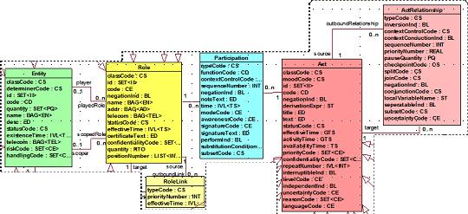
HL7 RIM Class Diagram

Slide 72
Definition of RIM Core Classes
Act – a discernible action of interest in the healthcare domain. An instance of Act is a record of that action. Acts definitions (master files), orders, plans, and performance records (events) are all represented by an instance of Act.
Act relationship – an association between two Acts. This includes Act to Act associations such as collector/component, predecessor/successor, and cause/outcome. The semantics of the association is captured by the Act Relationship attributes.
Entity - a physical thing or an organization/group of physical things capable of participating in Acts. This includes living subjects, organizations, material, and places.
Participation – an association between a Role and an Act representing the function assumed by the Role within the context of the Act. A single Role may participate in multiple Acts and a single Act may have multiple participating Roles. A single Participation is always an association between a particular Role and a particular Act.
Role – a classification/specialization of an Entity defined by the relationship of the playing Entity to a scoping Entity. An example of Role is “Employee”. An employee is a classification attributed to a person which has an employment relationship with an organization (Employer).
Role Link – An association between two Roles. It is used to capture relationships that exists between Entities other than the scoping relationships. A single Role may have a Role Link with multiple other Roles. A single Role Link is always between two distinct instances of Role.

Slide 73
HL7 V3 Message Design Information Models
RIM: Reference Information Model
D-MIM: Domain Message Information Model
R-MIM: Refined Message Information Model
HMD: Hierarchical Message Definition
RIM
Derive
D-MIM
Restrict
R-MIM
Serialize
HMD

Slide 74
HL7 V3 Message Development Framework
Application
Trigger
RIM
Role
Event
Information Modeling
Derive
Storyboard
Sender
Receiver
D-MIM
Triggers
Restrict
References
Interaction
R-MIM
Example
Serialize
Interaction Modeling
HMD
Message Design
Restrict
Storyboard
Content
Message
Example
Type
Use Case Modeling

Slide 75
HL7 V3 Message Development Methodology: How
Use Case Modeling
Produce a storyboard example
Generalize the storyboard example into a storyboard
Information Modeling
Define classes, attributes, datatypes, and relationships
Define vocabulary domains, code systems, and value sets
Define states, trigger events, and transitions
Interaction Modeling
Define application roles
Define interactions
Message Design
Define D-MIM, CMETs, and R-MIMs
Define HMD and Message Types

Slide 76
HL7 V3 Methodology (in English): How
What application interface problem are we trying to solve?
What application systems are within the scope of the problem domain?
What events initiate communication between applications?
What information needs to be communicated between the in-scope applications?
What is the definition, format, and interrelationship of the information to be communicated?
How should the information to be communicated between applications be structured and packaged?

Slide 77
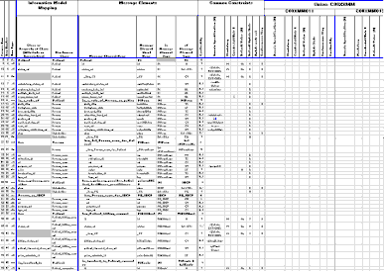
HL7 V3 Message Design Information Models
RIM
D-MIM
R-MIM
HMD

Slide 78
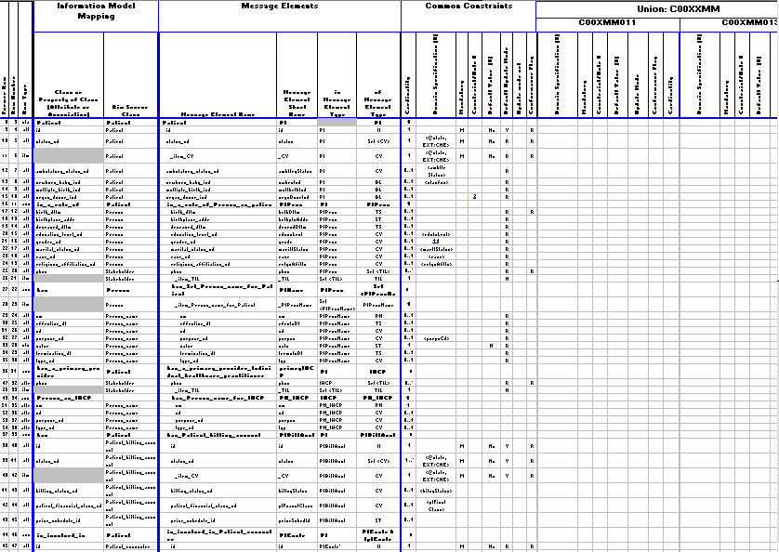
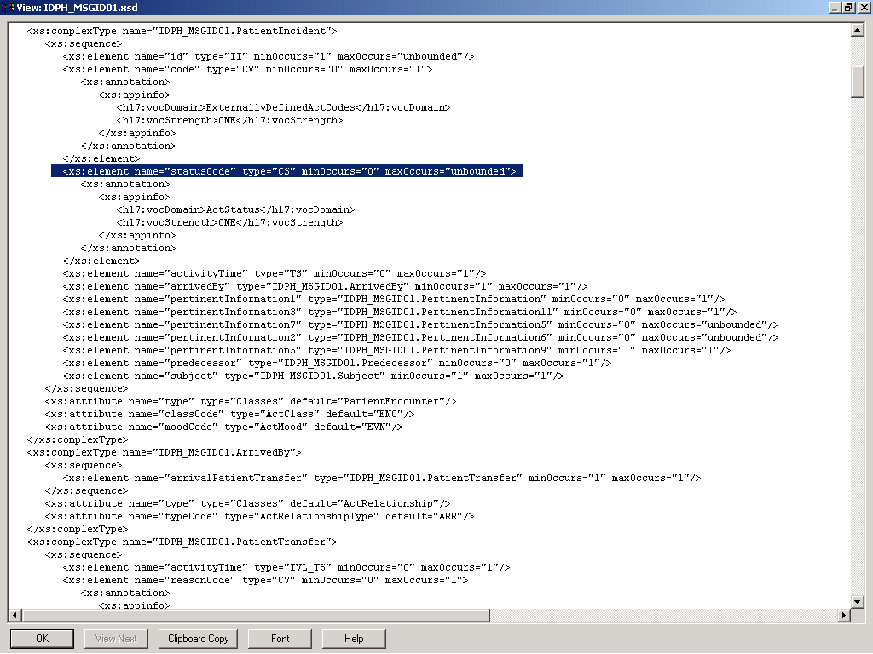
HL7 XML Schema Generator
HL7 Vocabulary
Specification
Hierarchical Message
Definition
And
CMET Specifications
HL7 XML
Schema
Generator
XML Schema
Specification
HL7 Data Type
Specification

Slide 79
HL7 V3 Message Implementation Technology
Hierarchical Message
Definition
And
CMET Specifications
XML Schema
Specification
HL7
Message
HL7
Data
Message
Instance
Message
Data
Creation
Parsing
HL7-Conformant
HL7-Conformant
Application
Application

Slide 80
HL7 Version 3.0 Data Type Specification
The HL7 Datatype Specification defines the structural format of the data carried in an attribute and influences the set of allowable values an attribute may assume.

Slide 81
HL7 Version 3.0 Data Types
HL7 data types define the structure and constrain the allowable values of attributes in the RIM.
The HL7 abstract data type specification declares the set of data types, identifies components of complex types, and defines relationships between data types.
The HL7 data type implementation technology specification defines constraints and operations for data types and describes how data types are to be represented in XML.
Data types are reusable atomic building blocks used to create all HL7 V3 information structures.
Each RIM attribute is assigned one data type; each data type is assigned to zero, one, or more RIM attribute.

Slide 82
What is a Data Type?
In ISO 11404, a "datatype" is defined as:
a set of distinct values, characterized by properties of those values, and by operations on those values
a datatype consists of three main features: a value space, a set of properties, and a set of characterizing operations
Generally the definitions of the scope of datatypes revolve around either or both of the following notions:
Immutability (the properties of the data type cannot change, instead a new instance is created: data types have no lifecycle)
The relationship between equality and identity (if two data types are equal they are the same instance)
Coherency of a single concept (each data type should represent a single concept space)

Slide 83
Data Type Categories
Basic Data Types
Text and Binary Data Types
Coded Data Types
Identification and Location Data Types
Name and Address Data Types
Quantity Data Types
Collection Data Types
Continuous Set Data Types
Uncertainty Data Types
Structured Text Data Types

Slide 84
Data Types
Basic Data Types
HXIT
ANY
BL
BL.NONNULL
Text And Binary Data Types
ED (Encapsulated Data)
ED.IMAGE
ED.TEXT
ED.DOC
ED.DOC.INLINE
ED.DOC.REF
ED.SIGNATURE
ED.STRUCTUREDTEXT
ED.STRUCTUREDTITLE
ST (Character String)
ST.NT
SC (Coded String)
SC.NT
Coded Data Types (Terminology)
CD (Concept Descriptor)
CD.CV (Coded Value)
CS (Coded Simple Value)
Identification and Location Data Types
TEL (Telecommunication Address)
TEL.URL
TEL.PERSON
TEL.PHONE
TEL.EMAIL
II (Instance Identifier)
Name and Address Data Types
ADXP (Address Part)
AD.Part (Address)
AD (Address)
ENXP (Entity Name Part)
EN (Entity Name)
EN.TN (Trivial Name)
EN.PN (Person Name)
EN.ON (Organization Name)

Slide 85
Datatype (continued)
Quantity Data Types
QTY (Quantity)
INT (Integer)
INT.NONNEG
INT.POS
CO (Coded Ordinal)
REAL (Real)
RTO (Ratio)
PQV (Physical Quantity Value)
PQ (Physical Quantity)
PQR (Physical Quantity Representation)
PQ.TIME
MO (Monetary Amount)
TS (Point in Time)
TS.DATE
TS.DATE.FULL
TS.DATETIME
TS.DATETIME.FULL
TS.BIRTH
Collection Data Types
COLL
DSET (Discrete Set)
LIST (Sequence)
GLIST (Generated Sequence)
SLIST (Sampled Sequence)
HIST (History)
BAG (Bag)
Continuous Set Data Types
QSET (Continuous Set)
QSU (QSET Union)
QSI (QSET Intersection)
QSD (QSET Difference)
QSP (QSET Periodic Hull)
QSS (QSET Set)
QSC (Coded QSET)
IVL (Interval)
IVL.LOW
IVL.HIGH

Slide 86
Datatypes (continued again)
IVL.WIDTH
PIVL (PeriodicInterval)
EIVL (Event-Related Periodic Interval of Time)
GTS.BOUNDEDPIVL
Uncertainty Data Types
UVP (Uncertain Value - Probabilistic)
NPPD (Non-Parametric Probability Distribution)
URG (Uncertain Range)
URG.LOW
URG.HIGH
Structured Text Data Types
StrucDoc.Base
StrucDoc.Br
StrucDoc.Sup
StrucDoc.Sub
StrucDoc.LinkHtml
StrucDoc.TitleFootnote
StrucDoc.Content
StrucDoc.Caption
StrucDoc.Captioned
StrucDoc.Paragraph
StrucDoc.CMFootnotes
StrucDoc.CMInline
StrucDoc.CMContent
StrucDoc.CMGeneral
StrucDoc.CMTitle
StrucDoc.List
StrucDoc.Item
StrucDoc.TableItem
StrucDoc.TCell
StrucDoc.TRow
StrucDoc.TRowPart
StrucDoc.TRowGroup
StrucDoc.ColItem
StrucDoc.Col
StrucDoc.ColGroup
StrucDoc.Table
StrucDoc.Text
StrucDoc.Title

Slide 87
HL7 Version 3.0 Vocabulary Specification
The HL7 Vocabulary Specification defines the set of all concepts that can be taken as valid values in an instance of a coded attribute or message element.

Slide 88
HL7 V3 Vocabulary Specification
The HL7 V3 Vocabulary Specification defines concept domains used in RIM coded Attributes and coded data type properties.
A concept domain is an abstract collection of interrelated concepts. It describes the purpose or intent of a coded attribute.
A value set is a collection of coded concepts drawn from one or more code systems. A concept domain may be associated with many value sets.
A context expression provides a means of designating which value set(s) within a given domain are applicable for a given usage context.
A coded concept has a concept code assigned by the coding system and a concept designation which names the referenced concept.
A coded concept may be a parent concept for a collection of additional concepts within the same code system.

Slide 89
HL7 V3 Vocabulary Specification Metamodel

Slide 90
Vocabulary Metamodel Description
A concept domain has a unique name and a description and is associated with zero, one, or more value sets.
If a concept domain is associated with more than one value set, a value set context is used to specify the context under which each value set is relevant.
A value set is associated with one concept domain. It has a name and description. A value set is a collection of coded concepts from one or more code system.
The coded concepts included in a value set may be drawn from a single coding system according to a defining expression. A value set’s defining expression defines what subset, projection, or partition of the code system concepts are within the scope of the value set.
Context expression describes constraints, if any, governing the use of value sets. Constraints include restrictions on jurisdictions, medical specialties, time periods, and other factors that together describe the context for which the value set is relevant.
Coded concepts have a concept code as assigned by the coding system and a concept designation. The coded concept designation is the name of the coded concept.
Multiple designations are allowed for a coded concept, primarily to accommodate multiple languages.
A coded concept may be the parent concept of a collection of coded concepts. The parent concept is a generalization of the child concepts it collects. The parent concepts and its child concepts are part of the same value set.

Slide 91
HL7 Common Terminology Services Project Scope
Establish a common model for terminology, and how it is related to meta-data (models of data) and data (the information itself)
Specify both an information and functional model that addresses the relationships and use of terminology in data – how data elements are constrained to ranges of possible codes, how selection lists built and queried, how terminological information is validated.
Specify the interactions between terminology providers and consumers – how users can submit unambiguous requests for corrections and extensions and how revisions to content are identified, distributed and integrated into running systems.
Specify how mapping between compatible terminologies and data models is defined, exchanged and revised.
Specify how logic-based terminologies can be queried about subsumption, classification and inferred relationships.

Slide 92
Vocabulary Binding
Information Model
Vocabulary Binding
Vocabulary Terms
Class
Vocabulary
Domain
Code
System
0..1
1
0..*
0..1
1
0..*
0..*
0..*
0..*
0..*
Attribute
Value Set
Coded
Concept
0..*
0..1
0..*
0..*

Slide 93
HL7 Version 3.0 Reference Models
Reference Information Model
Data Type
Specification
Vocabulary
Specification

Slide 94
HL7 Version 3.0 Reference Models

Slide 95
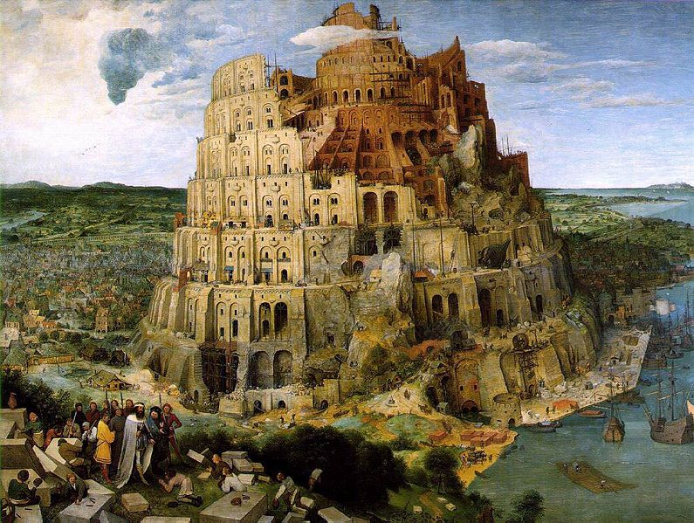
Semantic Interoperability Building Blocks
“…Behold, they are one people, and they have all one language; and this is only the beginning of what they will do; and nothing that they propose to do will now be impossible for them.” ~ Genesis 11:6

Slide 96
Semantic Interoperability Building Blocks

Slide 97
Metadata
The metadata repository contains a representation of the concepts depicted in information models of interest to the domain.
It includes descriptions of classes, class relationships, class attributes, attribute datatypes, and attribute terminology bindings.
Information models of interest include domain information models, legacy databases, and service information exchange payloads.
The metadata repository contains equivalence mappings between the constituent elements of information models.
The semantics of the metadata repository are based upon the ISO P11179 standard.
The metadata repository is constructed as a relational database.

Slide 98
Terminology
The terminology repository maintains the code system terms which comprise the values sets bound to attributes in information models.
It includes code systems, code system terms, code system term relationships, value sets, and value set members.
Code systems of particular interest include SNOMED CT, MedDRA, LOINC and other clinical code systems maintained in the NCI Metathesaurus.
The terminology repository includes equivalence relationships between code system terms from independent code systems.
The semantics of the terminology repository structure are based upon the HL7 Controlled Terminology Services specification.
The terminology repository is constructed as a relational database.

Slide 99
Ontology
The ontology repository contains semantic webs of clinical concepts specified in or derived from concepts depicted in information models and associated terminologies.
Ontologies describe individuals (instances), classes (concepts), attributes, and relations
Many of the ontologies of interest can be obtained from the National Center for Biomedical Ontologies (NCBO)
The ontology repository includes semantic links between terms in the terminology repository that go beyond taxonomic hierarchic, and subsumption relationships
The semantics of the ontology repository are base upon description logic.
The ontology repository is constructed as a collection of OWL-DL expressions.

Slide 100
Rules
The rules repository maintains the rules used to specify queries, inferences, derivation, semantic mappings, and dynamic behaviors of workflows and services.
Rules include IF..Then..Else constructs using terms defined in the metadata, terminology, and ontology repositories
The semantics of the rules repository are based upon Rule Markup Language (RuleML), permitting both forward and backward rules in XML for deduction, rewriting, and further inferential-transformational tasks.
The structure of the rules repository is XML.
A rule engine will be used to house, interpret, and enforce rules

Slide 101
Semantic Interoperability Building Blocks

Slide 102
Semantic Interoperability Infrastructure

Slide 103
Semantic Interoperability Infrastructure (SII)

Slide 104
Intra-Enterprise Information Sharing Infrastructure
Heterogeneous Applications
Application
Application
Application
Application
Application
A
B
C
D
E
Transformation
Inbound
Outbound
Message
Syntax
Semantic
Message
Processing
Mapping
Mapping
Processing

Slide 105
Inter-Enterprise Data Exchange Infrastructure
Heterogeneous Applications
Application
Application
Application
Application
Application
A
B
C
D
E
Transformation
Inbound
Outbound
EDI
Message
Message
EDI
Syntax
Semantic
EDI
Processing
Mapping
Mapping
Processing

Slide 106
Shared Services Layer
Heterogeneous Applications
Application
Application
Application
Application
Application
A
B
C
D
E
Reusable Services
Service
Service
Service
X
Y
Z
Transformation
Inbound
Outbound
EDI
Message
Syntax
Semantic
Message
EDI
Processing
Mapping
Mapping
Processing

Slide 107
Semantic Interoperability Infrastructure (SII)
Heterogeneous Applications
Application
Application
Application
Application
Application
A
B
C
D
E
Reusable Services
Service
Service
Service
X
Y
Z
Transformation
Inbound
Outbound
EDI
Message
Syntax
Semantic
Message
EDI
Processing
Mapping
Mapping
Processing
Knowledge
Metadata
Management
System

Slide 108
LAC DPH Project Scope

Slide 109
Los Angeles County Public Health Department PHIS-PACS Interface

Slide 110
Semantic Interoperability Infrastructure (SII)
Transformation
Inbound
Outbound
EDI
Message
Syntax
Semantic
Message
EDI
Processing
Mapping
Mapping
Processing
Knowledge
Metadata
Management
System

Slide 111
Metadata and Knowledge Management
Metadata
Management
Syntax Mapping
Semantic Mapping
Knowledge
Management

Slide 112
Service Functional Specifications

Slide 113
Operational Data Store (ODS)
Transformation
Inbound
Outbound
EDI
Message
Syntax
Semantic
Message
EDI
Processing
Mapping
Mapping
Processing
Integrated
Knowledge
Metadata
Data
Management
Repository
System
Operational Data Store

Slide 114
Integrated Data Repository (IDR)
Transformation
Inbound
Outbound
EDI
Message
Syntax
Semantic
Message
EDI
Processing
Mapping
Mapping
Processing
Integrated
Knowledge
Metadata
Data
Management
Repository
System
Operational Data Store
Derive
HL7 Reference Information Model
Integrated Data Repository

Slide 115
LAC PHD PHIS-PACS Interface with IDR

Slide 116
SNHD IDR Project Scope

Slide 117
SNHD Integrated Data Repository Project

Slide 118
Healthcare
Information Integration Infrastructure
HI³

Slide 119
Healthcare Information Integration Infrastructure

Slide 120
Electronic Data Interchange

Slide 121
Syntactic Interoperability

Slide 122
Semantic Interoperability

Slide 123
Semantic Data Integration

Slide 124
Semantically Sound Business Intelligence

Slide 125
Thank You
Abdul-Malik Shakir Principal Consultant
Shakir Consulting 1407 Foothill Blvd., Suite 145 La Verne, CA 91750
Office: (909) 596-6790 Mobile: (626) 644-4491 Email: AbdulMalik@ShakirConsulting.com

